Slide 1
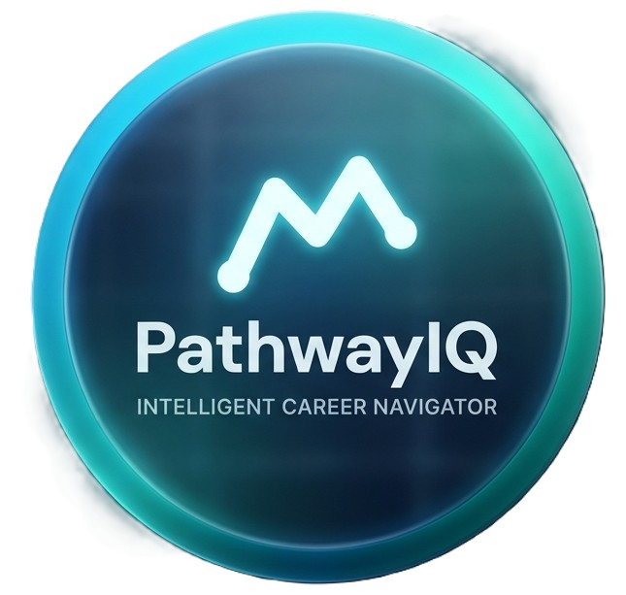





Skill Forecasting and
Semantic Career Pathway
Optimization Ecosystem
for Undergraduates
Al-driven career intelligence ecosystem for Sri Lankan IT undergraduates
Skill
Forecasting
Career Pathways
CV
Optimization
Interview Simulator
R26-IT-128
11/5/2026
Notes:
1

Slide 2
Addressing Proposal Feedback
01
PANEL COMMENT:
ARCHITECTURE
"Lacked an overall system diagram."
02
LITERATURE
PANEL COMMENT:
LITERATURE
"Lacked a proper literature review."
03
RESEARCH NOVELTY
PANEL COMMENT:
RESEARCH NOVELTY
"Unclear individual components & 'no research value' in one component."
R26-IT-128
11/5/2026
Notes:
2

Slide 3

Skill Forecasting and​ Semantic Career Pathway​ Optimization Ecosystem​
The Problem & Its Gravity
Global IT technologies evolve rapidly, while traditional academic curricula remain static. This creates a severe, widening knowledge gap for fresh graduates.
The Core Problem
Impact on Students
High career anxiety, wasted self-study hours on outdated tech, and resumes consistently rejected by automated systems due to missing contextual skills.
Impact on Industry
Despite thousands of IT graduates entering the workforce, companies face severe talent shortages and extended, costly retraining periods (bench time).
R26-IT-128
11/5/2026
Notes:
3

Slide 4



Skill Forecasting and​ Semantic Career Pathway​ Optimization Ecosystem​
Target Audience & Beneficiaries
IT Undergraduates
Academic Institutions
Tech Industry & Recruiters
R26-IT-128
11/5/2026
Notes:
4

Slide 5

Skill Forecasting and​ Semantic Career Pathway​ Optimization Ecosystem​
Who Benefits from the Solution
IT undergraduates preparing better for future careers
Recruiters and employers selecting suitable candidates
Universities and career counselors guiding students effectively
Reducing skill mismatch in the IT industry
Improving graduate employability and career readiness
R26-IT-128
11/5/2026
Notes:
5

Slide 6
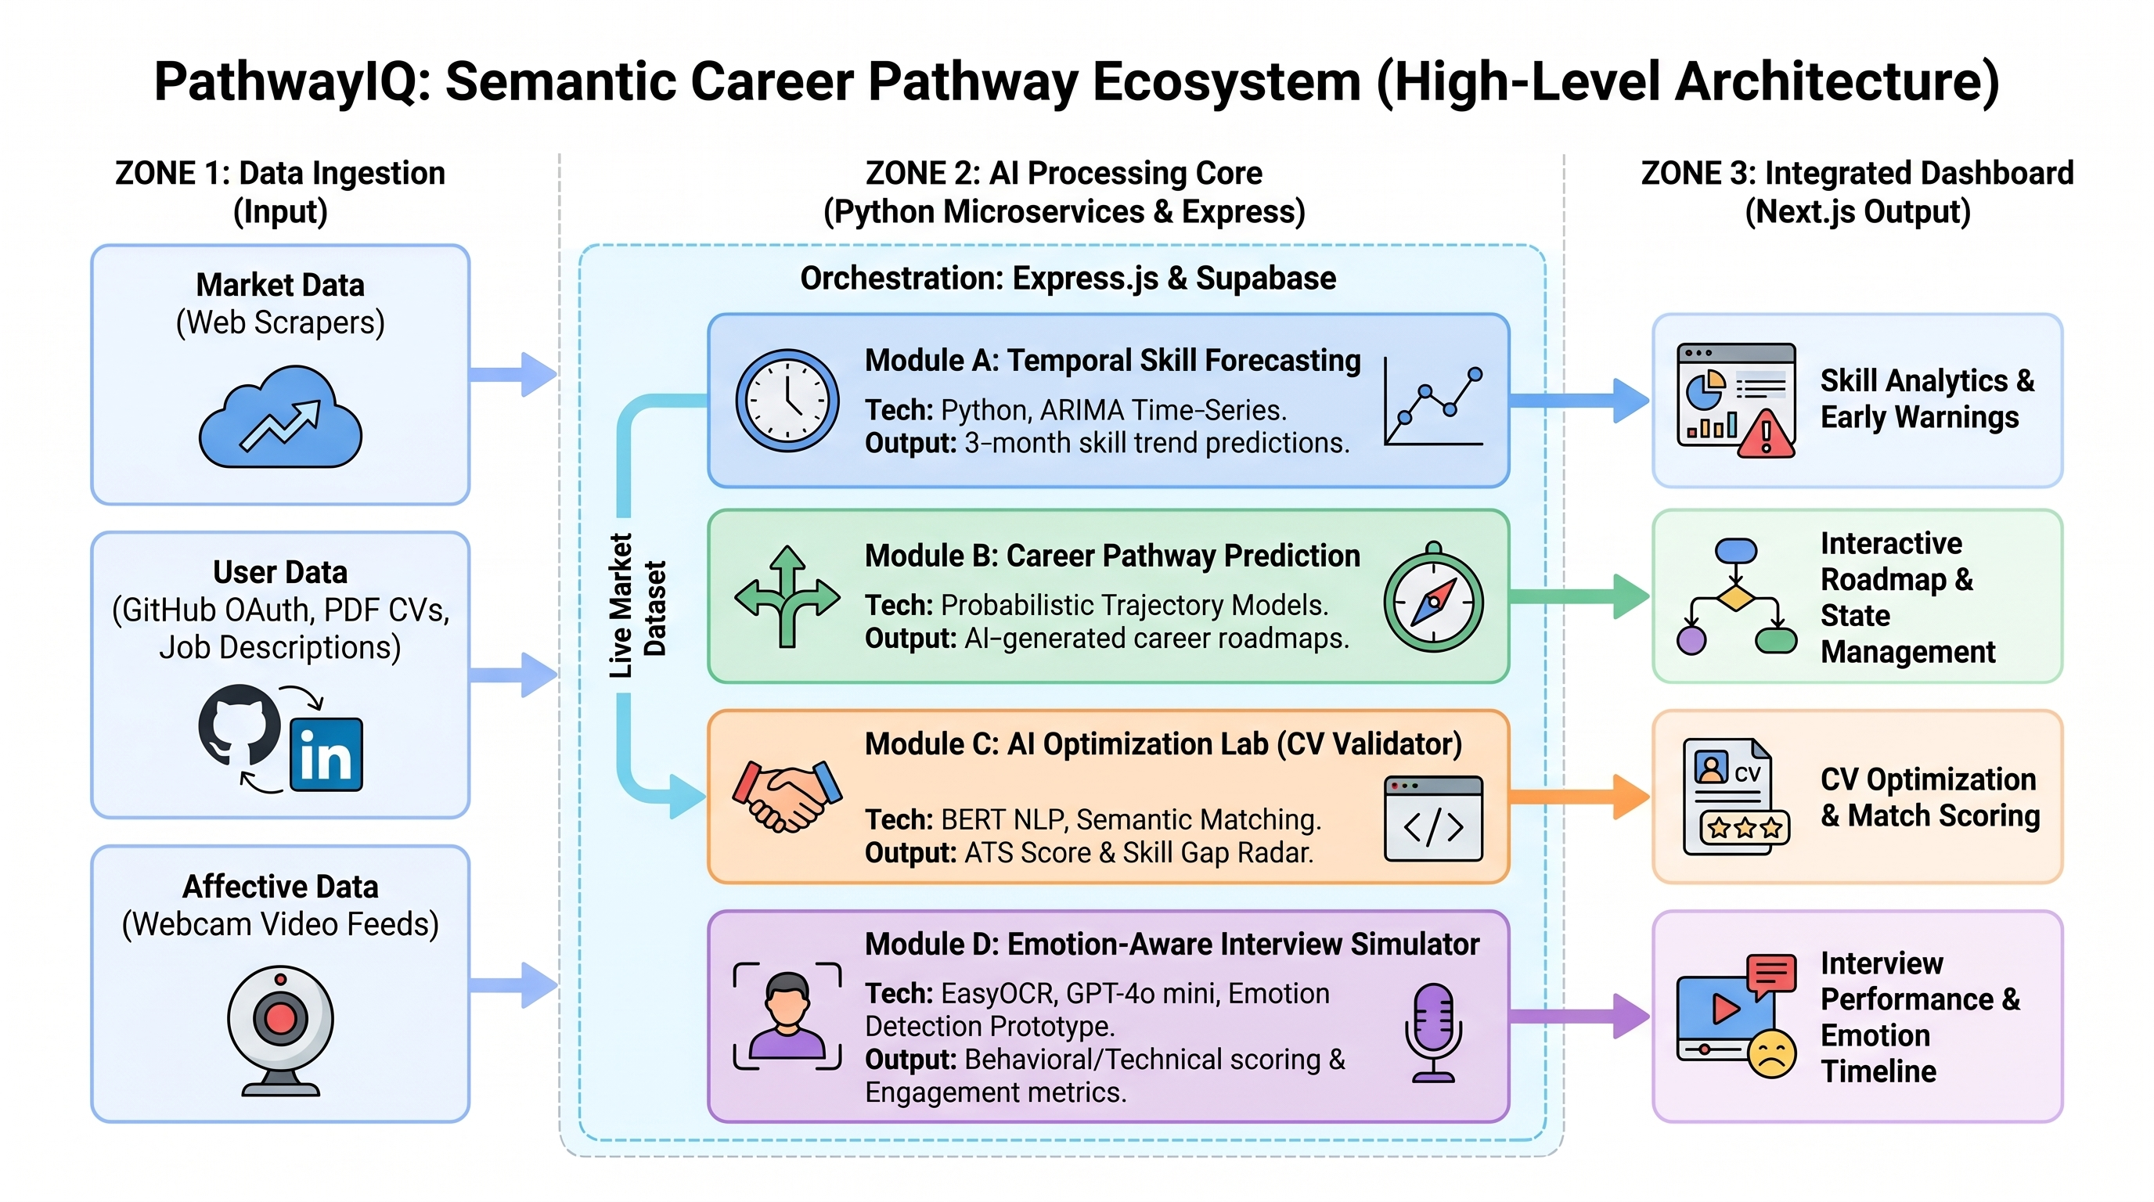
High-Level System Architecture
R26-IT-128
11/5/2026
Notes:
6

Slide 7


Literature review
Existing Systems
Pathway IQ
•Only show current skill demand - no forecasting.
•Built for global markets, not Sri Lanka.
•CV tools match keywords only - no context.
•No verification of actual coding ability.
•Interview tools give no emotion feedback.
•Features exist as separate, unconnected tools.
• Forecasts which skills will be in demand up to 3 months ahead.
•Trained on local Sri Lankan job market data.
•Reads CVs in context to accurately identify skills. Validates claimed skills against real code on GitHub.
•Detects emotions during mock interviews and gives feedback.
•All features combined in one platform for students.
R26-IT-128
11/5/2026
Notes:
7

Slide 8
Hybrid Proficiency Validation Framework
IT22091802 | PRASADI R.D.S
Specialization: Information and Communication Technology
11/05/2026
IT22091802 | PRASADI R.D.S | R26-IT-128

Slide 9
Hybrid Proficiency Validation Framework
How the solution will address the Sub-Problem
Graduates list skills on CVs with no proof of ability
extracts skills from the CV and verifies them against real GitHub code
Produces a verified evidence-based skill profile
User Requirements Addressed by the solution
Upload CV and get instant skill extraction
Each skill rated as Beginner, Intermediate, or Expert
Gap report shows what to improve before applying
11/05/2026
IT22091802 | PRASADI R.D.S | R26-IT-128

Slide 10
Hybrid Proficiency Validation Framework
Design Excellence / Contribution
Goes beyond keyword matching and understands technical context
Proficiency is evidence-based, not self-reported
Reduces hiring mismatch by validating what students actually know
User Feedback on Prototype
Skill gap report was clear and actionable
Users liked seeing which GitHub project proved each skill
Most valued feature: evidence-based proficiency scoring
11/05/2026
IT22091802 | PRASADI R.D.S | R26-IT-128

Slide 11
Semantic Skill Forecasting Engine
IT22154408 RATHNAYAKE KDV
Specialization: Information and Communication Technology
11/05/2026
IT22154408| RATHNAYAKE KDV | R26-IT-128

Slide 12

Semantic Skill Forecasting Engine
How the Solution Addresses the Prototype
The Problem
Students face high uncertainty about which skills will be required by the time they graduate. Existing platforms only show past or current job postings
The Solution
Our prototype predicts the future. It uses AI to generate a 3 month proactive demand forecast, showing students exactly where the market is heading.
User Requirements Addressed by the Solution
Automated Sourcing
Dark Data Extraction
Smart Grouping
11/05/2026
IT22154408| RATHNAYAKE KDV | R26-IT-128

Slide 13


Semantic Skill Forecasting Engine
Design Excellence & Contribution
Early Warning Radar:
This is the core innovation. The system mathematically tracks global tech trends and calculates the exact time delay before they reach.
The Benefit:
This alerts local undergraduates to start learning emerging global skills before they become standard requirements in the market.
User Feedback on Prototype
Usability Testing
Behavioral Impact
Problem Validation
11/05/2026
IT22154408| RATHNAYAKE KDV | R26-IT-128

Slide 14
Career Pathway Predictor
IT22153890 | ALPHONSO S. R. P. A. M. D. N.
Specialization: Information Technology
11/05/2026
IT22153890 | ALPHONSO S. R. P. A. M. D. N. | R26-IT-128

Slide 15
Career Pathway Predictor
How the solution will address the Sub-Problem
Analyzing real career histories of Sri Lankan IT professionals
Building a “career map” showing job progressions
Giving probability scores for each next role
Showing skill gaps, you must fill before moving to the next role
User Requirements addressed by the Solution
See probable career paths based on real local data, not generic role lists
Understand why a path is suggested (shared skills, role transition patterns)
Know what skills to learn next before applying
Compare multiple trajectories (e.g., technical vs. managerial tracks)
11/05/2026
IT22153890 | ALPHONSO S. R. P. A. M. D. N. | R26-IT-128

Slide 16
Career Pathway Predictor
Design Excellence / Contribution
Unlike generic global tools, our solution is local-first and explainable:
Uses a knowledge graph (like a smart map of job transitions) Not just a list of suggestions
Predicts up to 5 career steps ahead with time estimates
Highlights missing skills for each step
Provides interactive graphs
User Feedback on Prototype
Students: “Finally, a tool that shows realistic Sri Lankan career moves”
Reduced confusion about role requirements
Skill gap visualization helped prioritize learning
Career counselors: “We can now advise students with real evidence”
Requested improvement: Add filtering by company size and remote-work trends
11/05/2026
IT22153890 | ALPHONSO S. R. P. A. M. D. N. | R26-IT-128

Slide 17
INTERVIEW SIMULATOR
IT22291264 | KAVINDU D. M. G.
Specialization: Information and Communication Technology
11/05/2026
IT22291264 | KAVINDU D. M. G. | R26-IT-128

Slide 18
INTERVIEW SIMULATOR
How the solution will address the Sub-Problem
Many graduates cannot prove real interview skills
The interview module evaluates technical and communication abilities
AI analyzes responses and generates performance feedback
Helps recruiters identify skilled and job-ready candidates
User Requirements addressed by the Solution
Conduct mock technical interviews automatically
Evaluate communication and technical knowledge simultaneously
Provide instant interview scoring and feedback
Identify weak areas requiring
improvement before job applications
11/05/2026
11/05/2026
IT22291264 | KAVINDU D. M. G. | R26-IT-128

Slide 19
INTERVIEW SIMULATOR
Design Excellence / Contribution
Designed a simple and user-friendly interview interface
Integrated AI-based evaluation for efficient assessment
Generates instant interview performance feedback
Contributed to interview workflow and evaluation design
User Feedback on Prototype
Add more real-world technical interview questions
Clear interview process and feedback reports.
Most valued feature: evidence-based proficiency scoring
11/05/2026
IT22291264 | KAVINDU D. M. G. | R26-IT-128

Slide 20
Commercialization
Market & Persona
Primary: IT undergraduates seeking career guidance
Secondary: University career guidance units
Enterprise: HR teams and tech recruiters
Unique Edge
Only platform combining skill forecasting, career paths, CV verification and interview simulation
Localised for Sri Lankan IT job market
Evidence-based — not self-reported or keyword-based
Sustainability
Freemium: Core features free for all students
B2C Premium: Full platform access for individuals
B2B Licensing: Institutional access for universities and recruiters
Cost Recovery
Low setup cost : cloud-based microservice architecture
Break-even via small percentage of premium conversions
Scales efficiently as user base grows

Slide 21


